Slide 1
Battle of Neighbourhoods
Applied Data Science Capstone project

Slide 2
Contents
Introduction
Problem Statement
Data Visualization
Clustering
Analysis
Results
Conclusion

Slide 3
Introduction
Hyderabad is one of the most densely populated area and MetroPolitan City in India.
Being the largest city in India, there is no doubt about the diversity of the population. The multiculturalism is seen through the various neighborhoods including; Andhra Pradesh, Telangana, Maharashtra,Orissa, TamilNadu and many more.
Hyderabad being the hub of interactions between ethnicities, brings many opportunities for entrepreneurs to start or grow their business. It is a place where people can try the best of each culture, either while they work or just passing through.
Hyderabad is well known for its great food. Hyderabad is well known for Hyderabadi Dhum Biryani and Irani Chai.

Slide 4
Problem Statement
The objective of this project is to use Foursquare location data and regional clustering of venue information to determine what might be the ‘best’ neighborhood in Hyderabad to open a restaurant

Slide 5
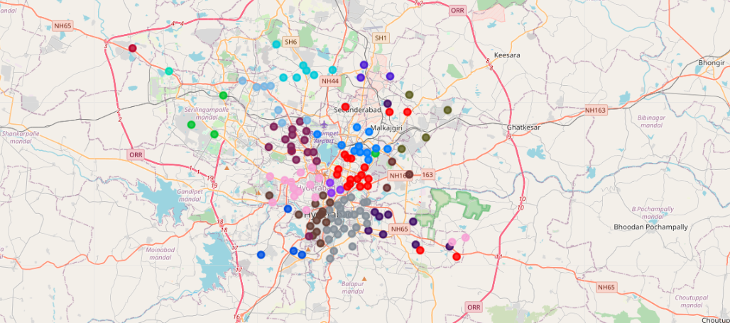
Data Visualization

Slide 6
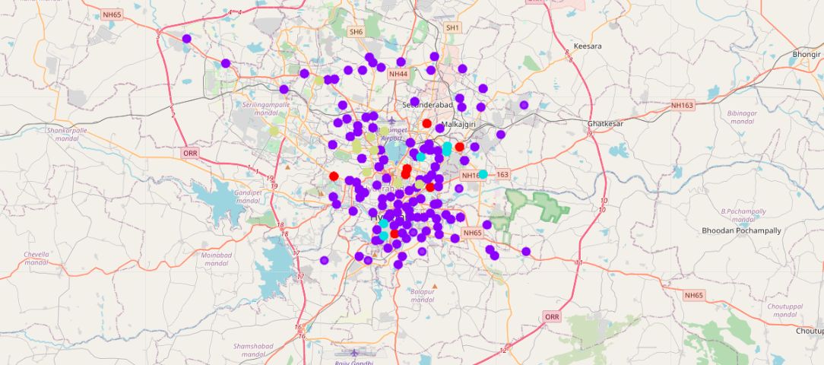
Clustering

Slide 7
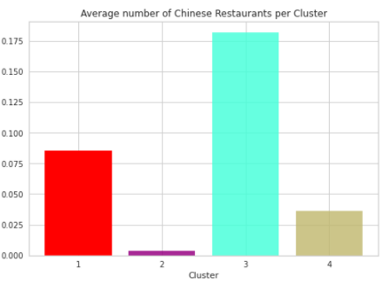
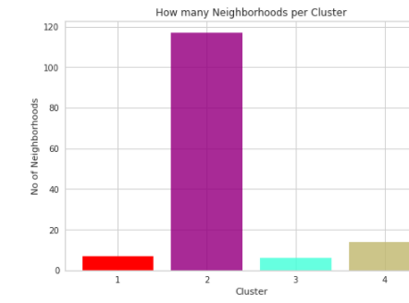
Analysis

Slide 8
Results
Cluster3 have highest number of Chinese Restaurants.So it is not a good idea to open a restaurant in secunderabad,chandanagar areas(Cluster3) due to heavy competition
Cluster2 have least number of Chinese Restaurants but highest number of neighborhoods
The first best neighborhood to open a new authentic Chinese Restaurant is Central Hyderabad zones like 'Erstwhile Circle – I and Erstwhile Circle – III
Out of these 2 zones,Erstwhile Circle -III is best place for any new venture because of the high densed population and busy area.
Chinese restaurant with good tasty food and hygienic infrastructure would definitely gain profits.
Himayathnagar,Ameerpet, Panjagutta,KPHB colony are few ideal places to open a Chinese Restaurant in Hyderabad

Slide 9
Conclusion
In conclusion, to end this project, we had an opportunity on a business problem, and it was tackled in a way that was similar to how a genuine data scientist would do. We utilized numerous Python libraries to fetch the information , to control the content and to break down and visualize those datasets. We have utilized Foursquare API to investigate the settings in neighborhoods of Hyderabad, get great measure of data from online web pages. We also visualized utilizing different plots present in seaborn and matplotlib libraries.

